Slide 1
Department of Artificial Intelligence
Handwritten Math Expression Solver

Slide 2
TEAM DETAILS
S.NO | Name | Department | Contribution ( What part of the project you contributed ) | Status
1 | SOORIYA S | ECE | Front-End and Back-End | Completed
2 | SASITHARAN A | ECE | ML Model | Completed
3 | LEELARAM R | IT | ML Model | Completed

Slide 3
ABSTRACT
A handwritten math expression solver is a system that can read and solve math problems written by hand. It uses image processing to capture the equation and artificial intelligence to recognize the numbers, symbols, and structure of the problem. Once the equation is understood, the system solves it step by step. This technology is helpful for students learning math and for automating tasks like checking homework or solving equations quickly. It can also assist in real-world applications, such as converting handwritten notes into digital formats. While it’s already effective, improvements are needed to handle different handwriting styles and complex math problems more accurately and efficiently, making it accessible to a wider audience.

Slide 4
OBJECTIVE
Develop a Handwritten Math Expression Solver:
Create a system that can accurately recognize and solve handwritten mathematical equations.
Design Symbol Recognition Models:
Leverage machine learning, particularly deep learning , to identify and classify handwritten math symbols.
Parse Mathematical Structure:
Develop algorithms to analyze and convert recognized symbols into a structured format.
Compute Solutions:
Integrate computational logic to evaluate and solve the parsed mathematical expressions.
Ensure Robustness:
Address challenges like varying handwriting styles, ambiguous symbols, and complex notations to improve accuracy.
Test and Validate:
Evaluate the system's performance on diverse datasets to ensure reliability and scalability.

Slide 5
FEATURE
Handwriting Recognition (OCR) – Accurately recognize handwritten numbers, symbols, and operators.
Expression Parsing – Convert handwritten input into a structured mathematical expression.
Equation Solving – Solve arithmetic, algebraic, and calculus-based expressions.
Multiple Input Methods – Support touchscreen drawing, stylus input, and image upload for
recognition.
Support for Complex Math – Handle algebra, trigonometry, calculus, matrices, and differential equations.
Handwriting Style Adaptation – Learn and adapt to user-specific handwriting styles over time.

Slide 6
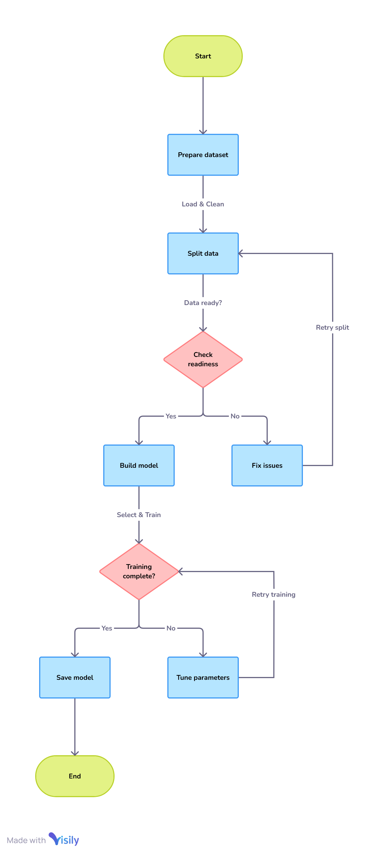
FLOWCHART

Slide 7
TECHNOLOGY USED
Frontend Technology
Backend Technology
What ML Model Used
HTML
Flask
CNN and OCN

Slide 8

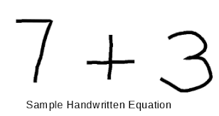
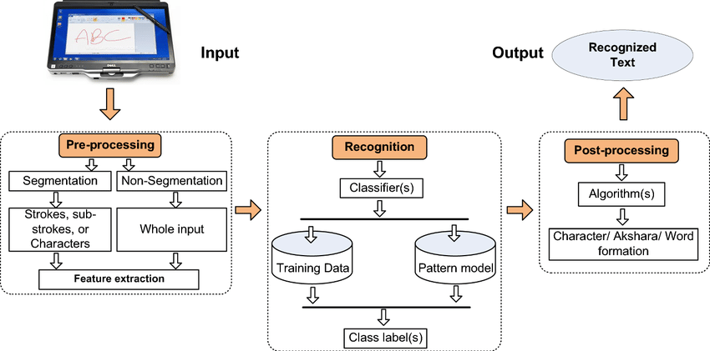
SYSTEM ARCHITECTURE

Slide 9


TARGET CUSTOMERS
Educational Institutions & E-Learning Platforms
Researchers & Mathematicians
Developers & AI Enthusiasts
Publishing & Digital Content Creation
Government & Educational Policy Makers
Smart Devices & AI Assistants

Slide 10
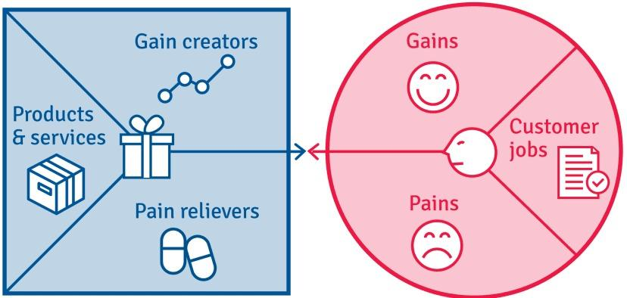
CUSTOMER VALUE PROPOSITION
CUSTOMER PROFILE
Gains
Automation and Efficiency
Improved Accuracy and Consistency
Scalability and Integration
Pains
Data Dependency and Accuracy issues
Computational Cost
Generalization Issues with handwritten input
Customer Jobs
Supporting Accessibility & Inclusion – Helping individuals with disabilities (e.g., visually impaired users) by integrating with text-to-speech software.
Improving E-Learning & Education – Teachers and students benefit from faster note-taking, digital assessments, and AI-assisted problem-solving.
Enhancing Competitive Edge – Companies integrating this technology can stand out in the EdTech and AI-driven OCR industries.

Slide 11
RESULT & CONCLUSION
Result:
The mathematical symbol classification model effectively identifies and classifies symbols with high accuracy. By leveraging a CNN-based approach, it streamlines digitization and automation for mathematical content.
Conclusion:
This solution enhances efficiency, accuracy, and accessibility in fields like education, research, and AI-driven applications. While challenges such as handwriting variations remain, continuous improvements in data quality and model optimization can further boost performance and usability.

Slide 12
Thank You

